Slide 1


K.RAMAKRISHNAN COLLEGE OF ENGINEERING
(AUTONOMOUS)
BRICK BREAKER GAME
Presented by,
Name : ABIRAMI.P
Register No. : 8115U23AD004
Roll. No. : AD2304
Year & Section : II YEAR

Slide 2
PRESENTATION OVERVIEW
Objective
System Architecture (Flow Diagram)
Technologies Used
Module Completion

Slide 3
OBJECTIVE OF THE PROJECT
The objective of the Brick Breaker game is for the player to control a paddle at the bottom of the screen to bounce a ball upward toward a wall of bricks. The ball will bounce off the paddle, walls, and bricks, breaking them upon collision. The game is won when all bricks are destroyed, and it's lost if the ball falls below the paddle

Slide 4
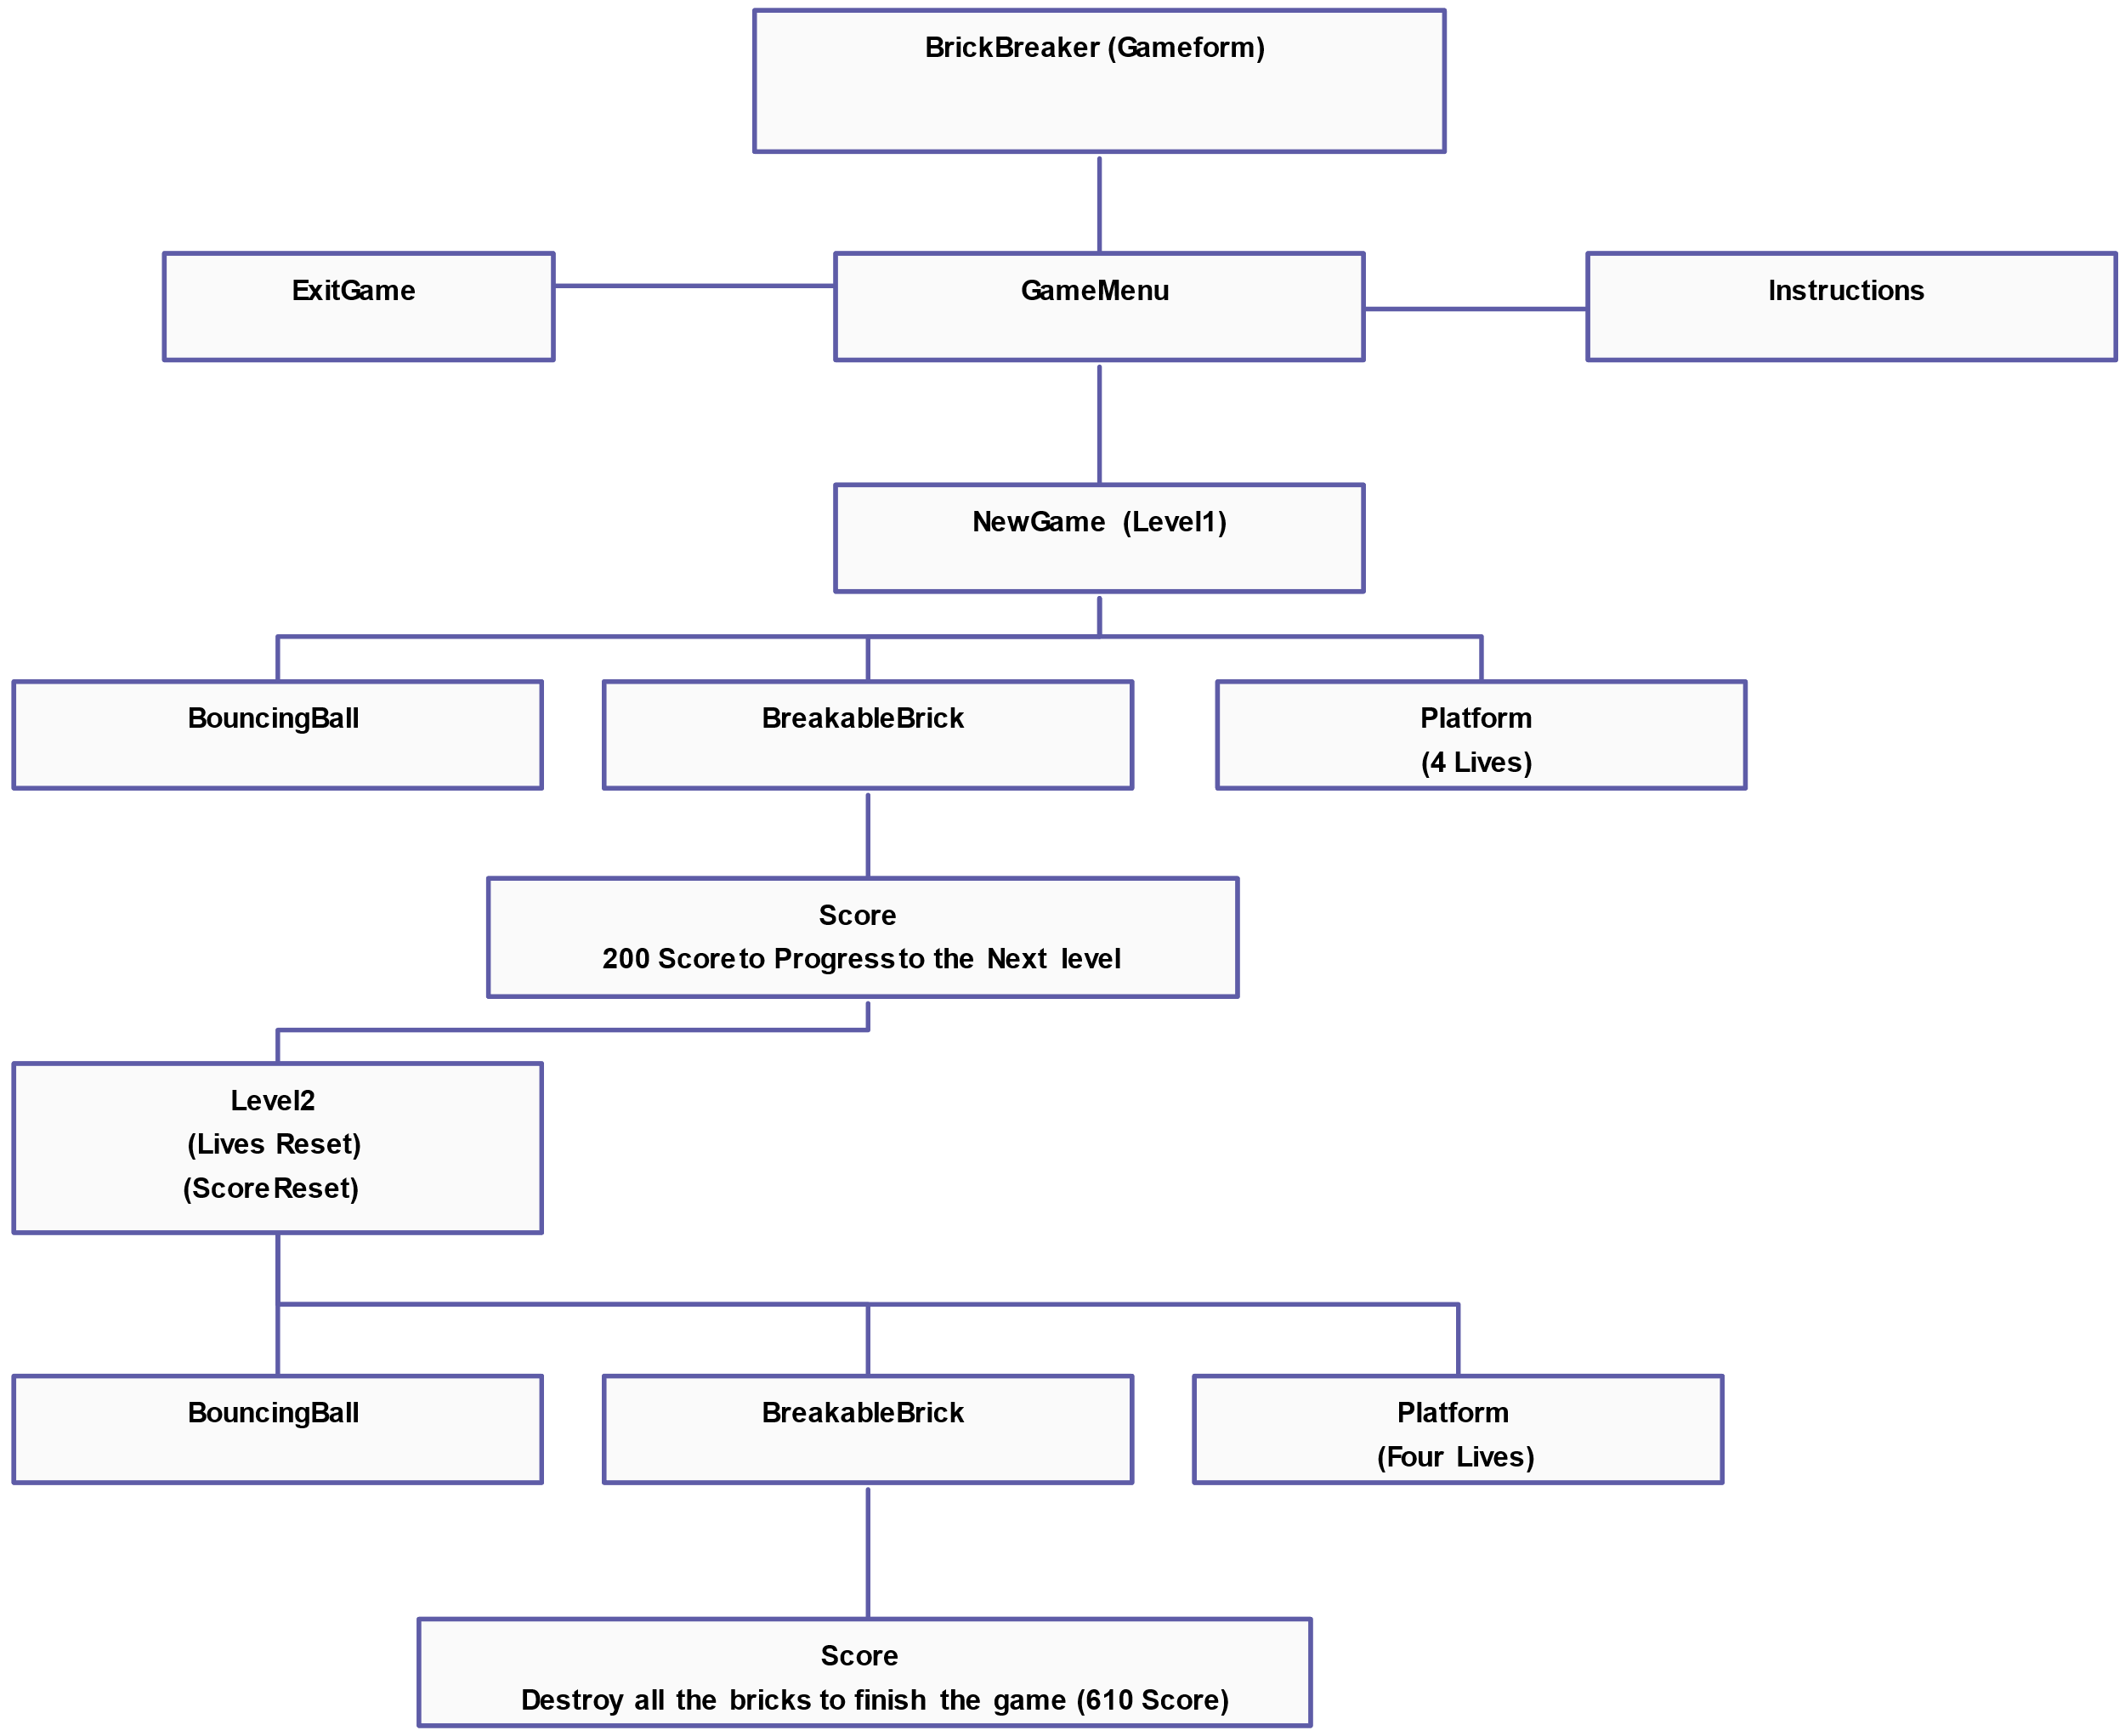
PROPOSED SYSTEM
ARCHITECTURE/FLOW DIAGRAM
.

Slide 5
Swing GUI Toolkit:
Used to create the game window and manage graphical user interface elements. Key components include:
JFrame: For the game window.
JPanel: For handling custom drawing and the game area (e.g., rendering bricks, paddle, ball).
Timer: For managing the game loop and controlling the pace of the game (frame rate).
AWT (Abstract Window Toolkit):
Provides classes for handling graphics and user input:
Graphics: To draw shapes like the paddle, ball, and bricks.
KeyListener: For capturing keyboard input to move the paddle.
Rectangle: To handle collision detection between the ball and objects.
Event-Driven Programming:
Java Programming Language:
Uses ActionListener and KeyListener for responding to user input (keyboard) and timer events for updating the game state.
TECHNOLOGIES USED

Slide 6
MODULE COMPLETION
MODULE 1: Main Class (BrickBreaker.java): The entry point for the game.
MODULE 2: Gameplay Class: Handles the core game logic, rendering, and updating the game state.
MODULE 3: Brick Class: Represents individual bricks.
MODULE 4 :Paddle Class: Represents the player's paddle.
MODULE 5 :Ball Class: Represents the ball.

Slide 7
MODULE 1
Main Class (BrickBreaker.java):
Purpose :
The entry point of the game. It creates the game window and starts the game by adding the gameplay logic.
Key Code:
Initialize the game window (JFrame) with necessary properties (size, visibility, close operation).
Add the Gameplay panel to the window to start the game.

Slide 8
MODULE 2
Gameplay Class:
Purpose:
Handles the main game loop, rendering game elements, detecting collisions, and processing user input.
Key Code:
paint(Graphics g): Draws the paddle, ball, bricks, and background.
actionPerformed(): Moves the ball and handles collision detection.
keyPressed(): Moves the paddle when left or right arrow keys are pressed.
Timer: Controls the game loop (updates the game state at fixed intervals).

Slide 9
MODULE 3
Brick Class:
Purpose:
Represents individual bricks and their state (visible or broken).
Key Code:
Stores each brick’s position and visibility.
draw(Graphics g): Draws visible bricks on the screen.

Slide 10
MODULE 4
Paddle Class:
Purpose:
Represents the player's paddle, controls its position, and handles rendering.
Key Code:
moveLeft() and moveRight() methods adjust paddle position.
draw(Graphics g): Draws the paddle on the screen.

Slide 11
MODULE 5
Ball Class:
Purpose: Represents the ball, handles its movement, and detects collisions with other objects (walls, paddle, bricks).
Key Code:
move(): Updates the ball’s position.
reverseX() and reverseY(): Reverses the ball's direction when hitting a wall or object.
draw(Graphics g): Draws the ball on the screen.

Slide 12
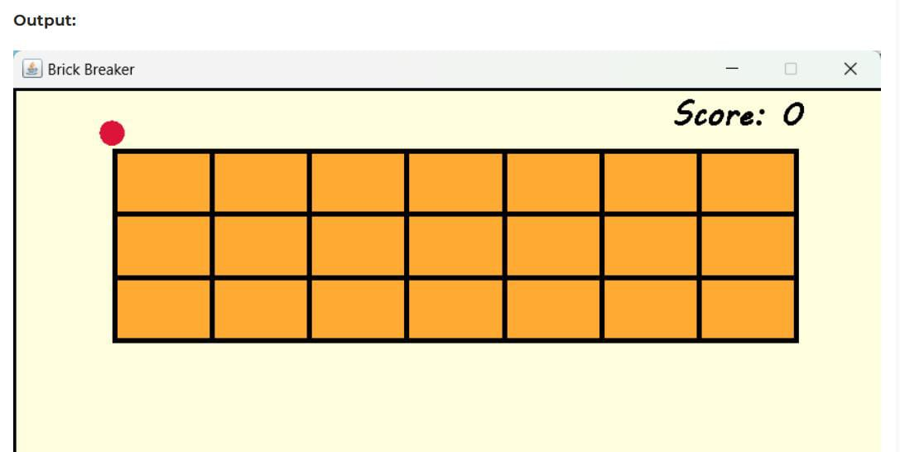
MODULE COMPLETION SCREENSHOT

Slide 13
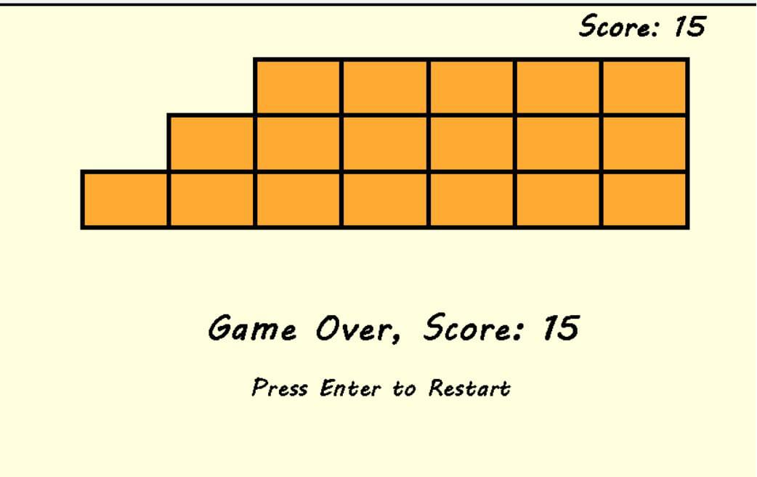
MODULE COMPLETION SCREENSHOT

Slide 14


